Slide 1
Data Center Networking
K. K. Ramakrishnan
UCR
(most of the slides – thanks to Prof. Dan Li, Tsinghua University, Beijing, China. A few from the textbook, and a couple from slides from V. Arun, Umass Amherst.

Slide 2
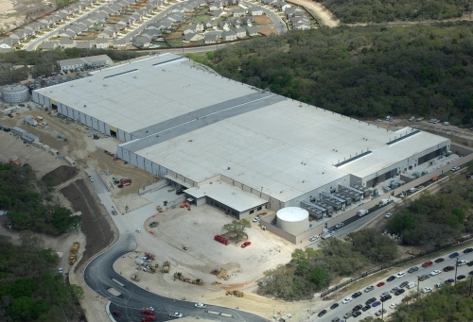

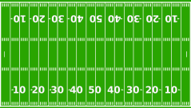

Cloud is built on Massive Datacenters
Range in size from “edge” facilities to megascale (100K to 1M servers)
Economies of scale
Approximate costs for a small size center (1K servers) and a larger, 400K server center.
Technology | Cost in small-sized Data Center | Cost in Large Data Center | Ratio
Network | $95 per Mbps/ Month | $13 per Mbps/ month | 7.1
Storage | $2.20 per GB/ Month | $0.40 per GB/ month | 5.7
Administra-tion | ~140 servers/ Administrator | >1000 Servers/ Administrator | 7.1
This data center is
11.5 times
the size of a football field
(Courtesy of Dennis Gannon, 2010)

Slide 3






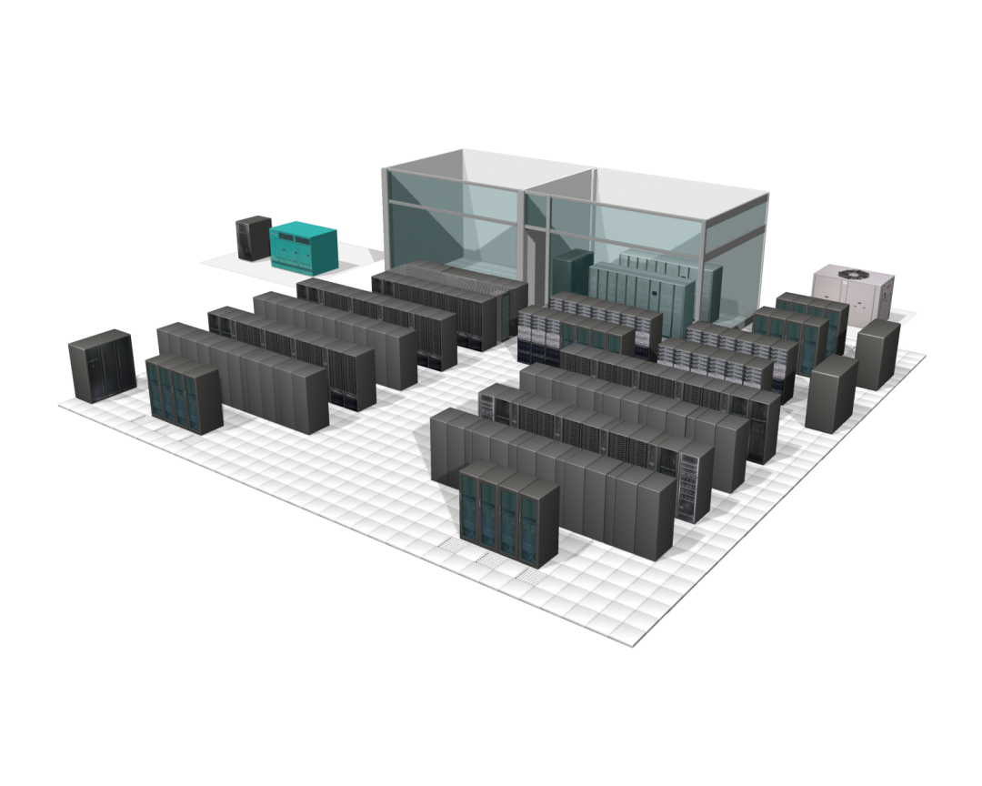

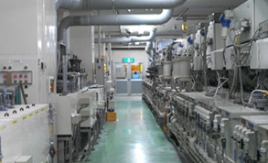




Data Centers
Collaboration
Empowered User
SLA Metrics
Global Availability
Reg. Compliance
Cloud
Computing
Data
Centers
Power & Cooling
Asset Utilization
Provisioning
Security Threats
Bus. Continuance
Notes:
While cloud computing is considered as a logical concept, it is in fact constructed by data centers.
A data center is a facility used to house computer systems and associated components, such as telecommunications and storage systems. It generally includes redundant or backup power supplies, redundant data communications connections, environmental controls (e.g., air conditioning, fire suppression) and security devices.

Slide 4
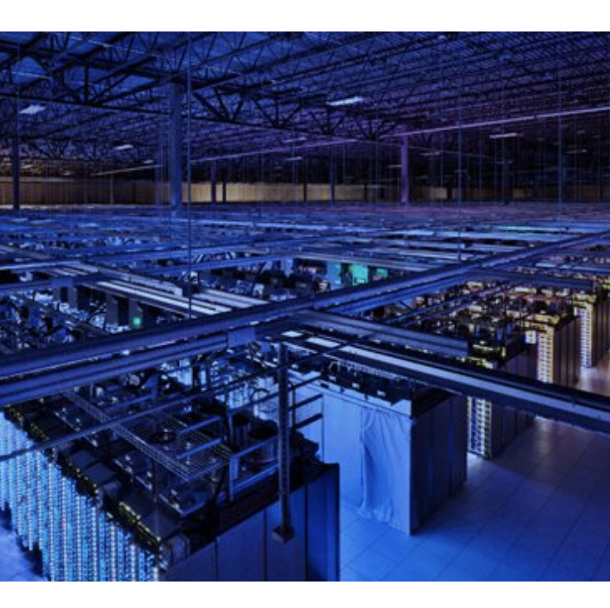
What are data centers?
Data centers are an aggregation of compute, memory, and storage resources.

Slide 5
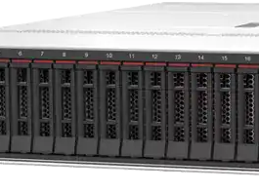
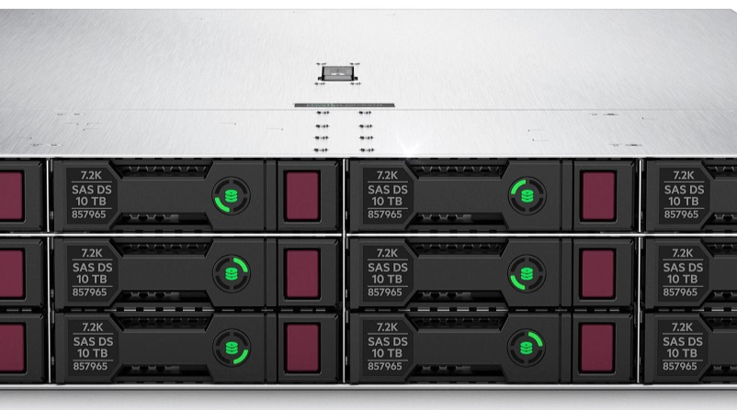
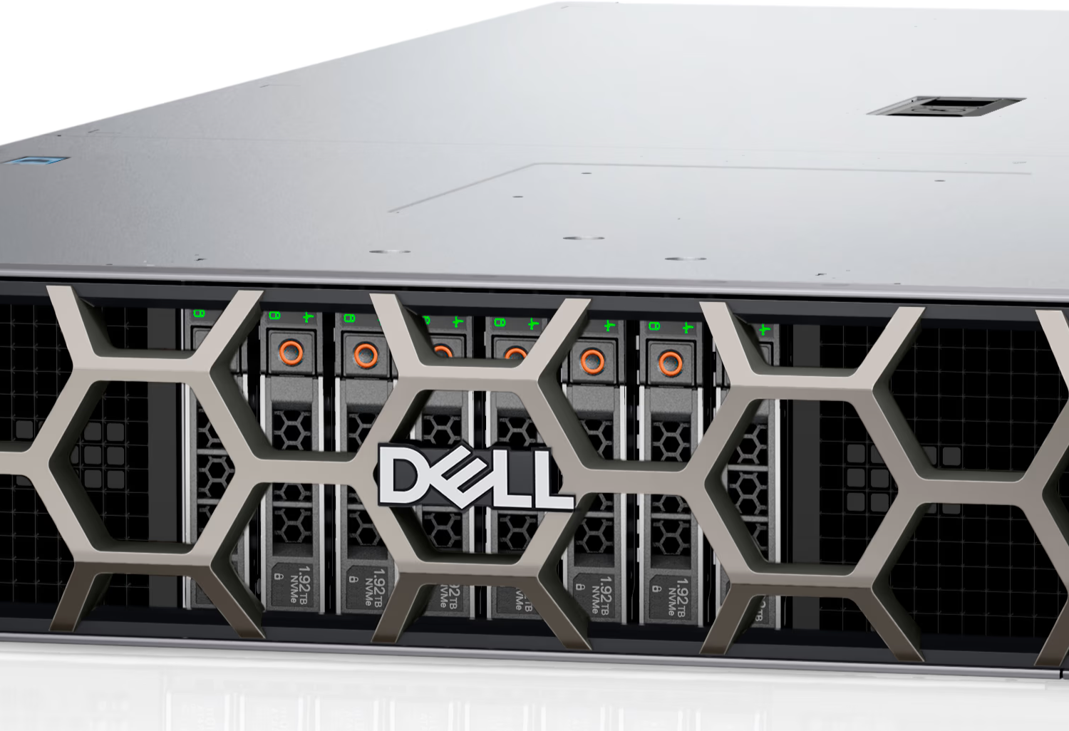
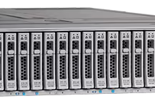
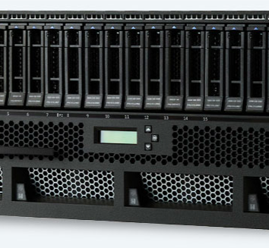
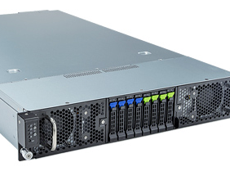
What is a server?
A server consists of
One or several power-hungry multi-core processors
Multiple GPU/FPGA/ASIC accelerators
Massive memory capacity
High-bandwidth networking bandwidth
Enormous persistent HDD/SSD storage
A server is a computing machine under a predefined form factor.

Slide 6
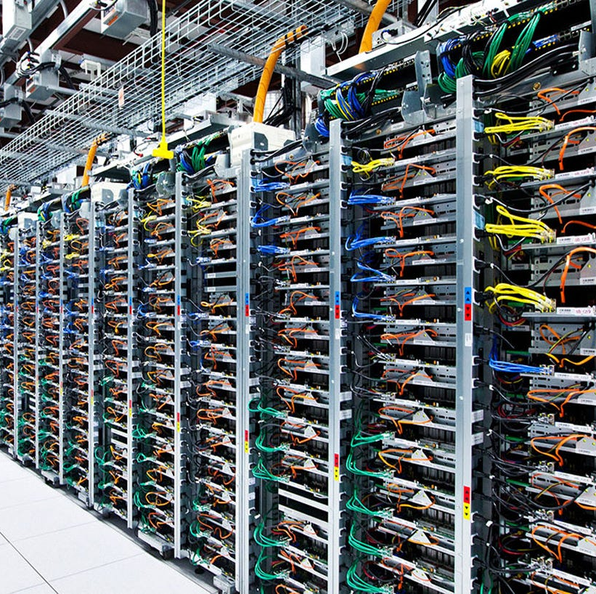
What are data center networks?
Data center networks connect servers

Slide 7

Data center networks
10’s to 1000’s of thousands of hosts/servers, often closely coupled, in close proximity:
e-business (e.g. Amazon – 28 data centers, 1.5 M servers, 2014)
content-servers (e.g., YouTube, Akamai, Apple, Microsoft)
search engines, data mining (e.g., Google – estimate had 2.5M servers in 2016)
challenges:
multiple applications, each serving massive numbers of clients
managing/balancing load, avoiding processing, networking, data bottlenecks
Inside a 40-ft Microsoft container,
Chicago data center

Slide 8
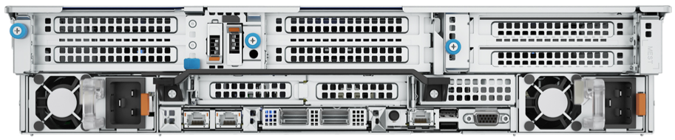

How do data center networks connect servers?
Data center networks connect servers via NIC ports!
Management port:
Configure and manage a baseboard management controller (BMC)
Management

Slide 9
How do data center networks connect servers?
Data center networks connect servers via NIC ports!
Control network port:
Load the server OS and set up the network
Initiate and upgrade the server configurations
Control

Slide 10
How do data center networks connect servers?
Data center networks connect servers via NIC ports!
Data network port:
Carry application traffic
Data

Slide 11
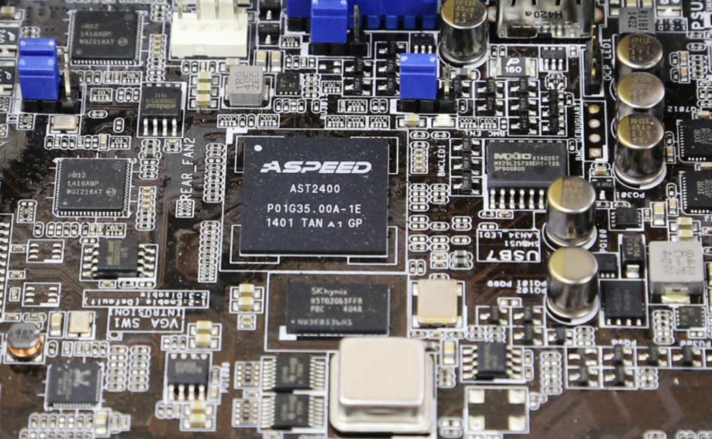
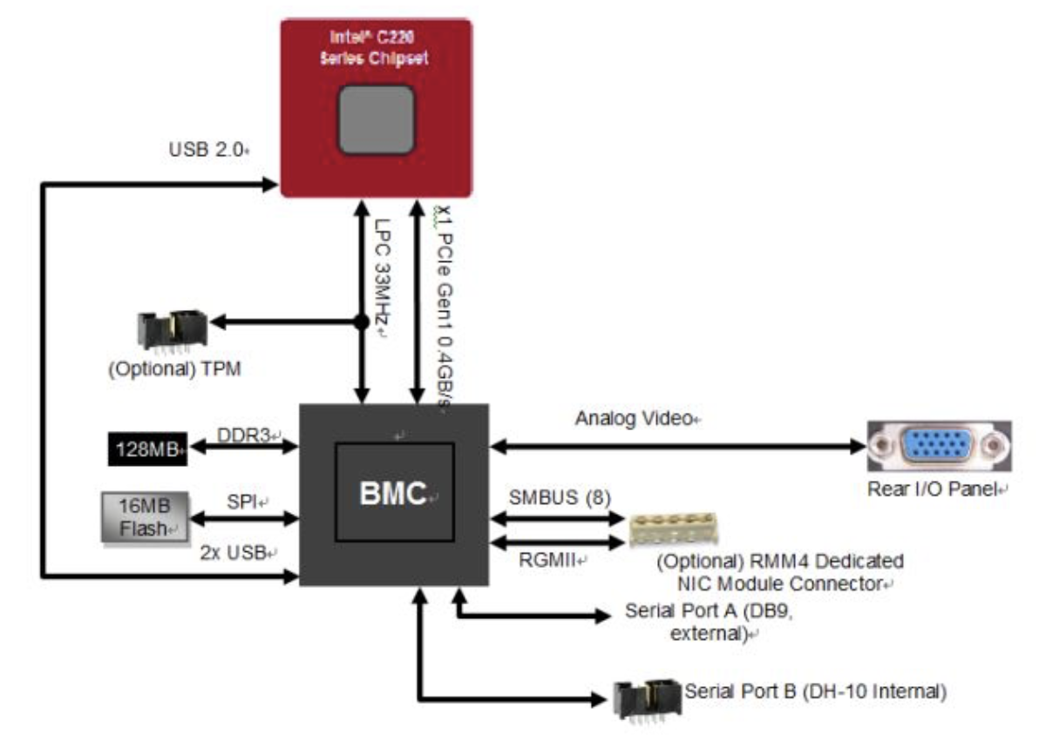
Data center networks provide connectivity for all three ports
Type #1: Management Traffic
BMC: an ARM-based SoC with graphics and control logic built-in
Vendor: ASPEED
There are non-ARM solutions

Slide 12
Data center networks provide connectivity for all three ports
Type #1: Management Traffic
Target user: server administrator
No need to enter the server room physically to perform tasks
Management traffic characteristics:
Reliable connectivity between server BMC and admin host
Low traffic volume
Low performance requirement
No server-server communication

Slide 13
Data center networks provide connectivity for all three ports
Type #2: Control Traffic
An out-of-band network for server configuration and maintenance
A 1G/10G/25G onboard integrated NIC or external one
OS load/upgrade, system setup, health monitoring, SSH, ...
Target user: server user or infrastructure engineer
Responsible for refactoring servers in a way that satisfies applications
Becoming increasingly important today

Slide 14
Data center networks provide connectivity for all three ports
Type #2: Control Traffic
An out-of-band network for server configuration and maintenance
A 1G/10G/25G onboard integrated NIC or external one
OS load/upgrade, system setup, health monitoring, SSH, ...
Target user: server user or infrastructure engineer
Responsible for refactoring servers in a way that satisfies applications
Becoming increasingly important today
Control traffic characteristics:
Reliable connectivity control port and control host
Modest traffic volume
Modest performance requrirement
Partial server-server communication

Slide 15
Data center networks provide connectivity for all three ports
Type #3: Data Traffic
An in-band network for data center applications
Dominated by external PCIe-based NICs
Vendor: NVIDIA/Mellanox, Broadcom, Intel, ...
Target user: application developers
Bandwidth keeps increasing: 1G->10G->25/40G->100G->200G->400G
More data ports are added for different use cases.

Slide 16
Data center networks provide connectivity for all three ports
Type #3: Data Traffic
An in-band network for data center applications
Dominated by external PCIe-based NICs
Vendor: NVIDIA/Mellanox, Broadcom, Intel, ...
Target user: application developers
Bandwidth keeps increasing: 1G->10G->25/40G->100G->200G->400G
More data ports are added for different use cases.
Data traffic characteristics:
Reliable connectivity among servers
High traffic volume
High performance requirement

Slide 17
Data center networks
load balancer: application-layer routing
receives external client requests
directs workload within data center
returns results to external client (hiding data center internals from client)
Internet
Border router
Load
balancer
Load
balancer
Access router
B
Tier-1 switches
A
C
Tier-2 switches
TOR switches
Server racks
1
2
3
4
5
6
7
8

Slide 18
Data center networks
rich interconnection among switches, racks:
increased throughput between racks (multiple routing paths possible)
increased reliability via redundancy
Tier-1 switches
Tier-2 switches
TOR switches
Server racks
1
2
3
4
5
6
7
8

Slide 19
Broad questions
How are massive numbers of commodity machines networked inside a data center?
Virtualization: How to effectively manage physical machine resources across client virtual machines?
Operational costs:
Server equipment
Power and cooling
Networking

Slide 20
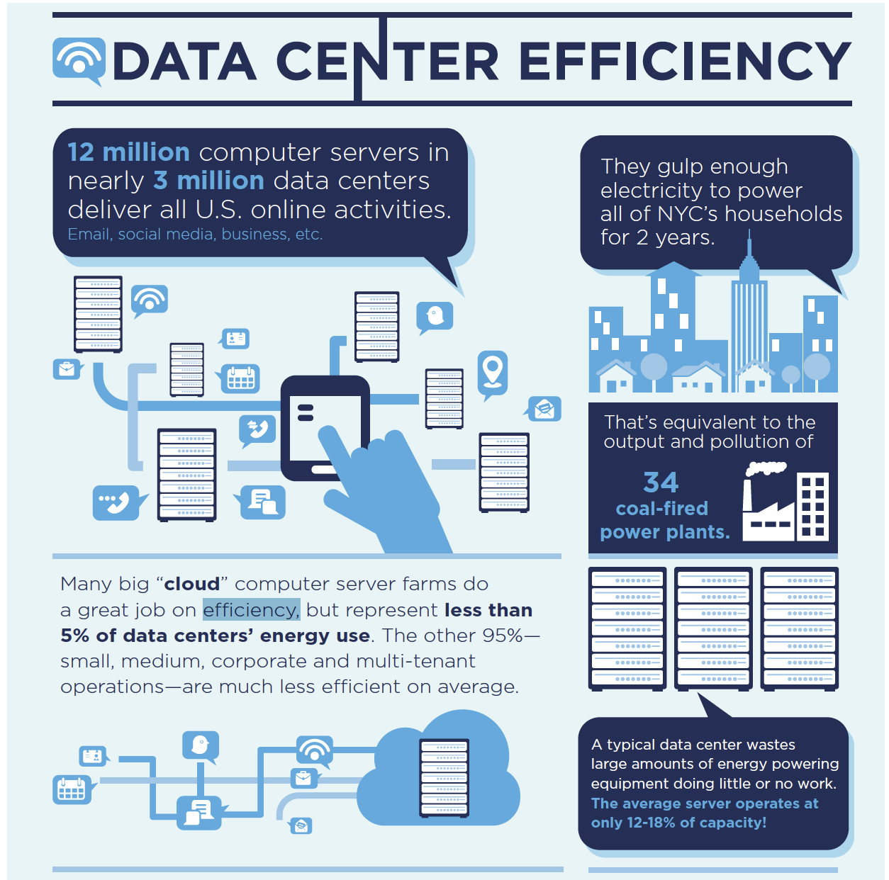
Source: NRDC research paper

Slide 21
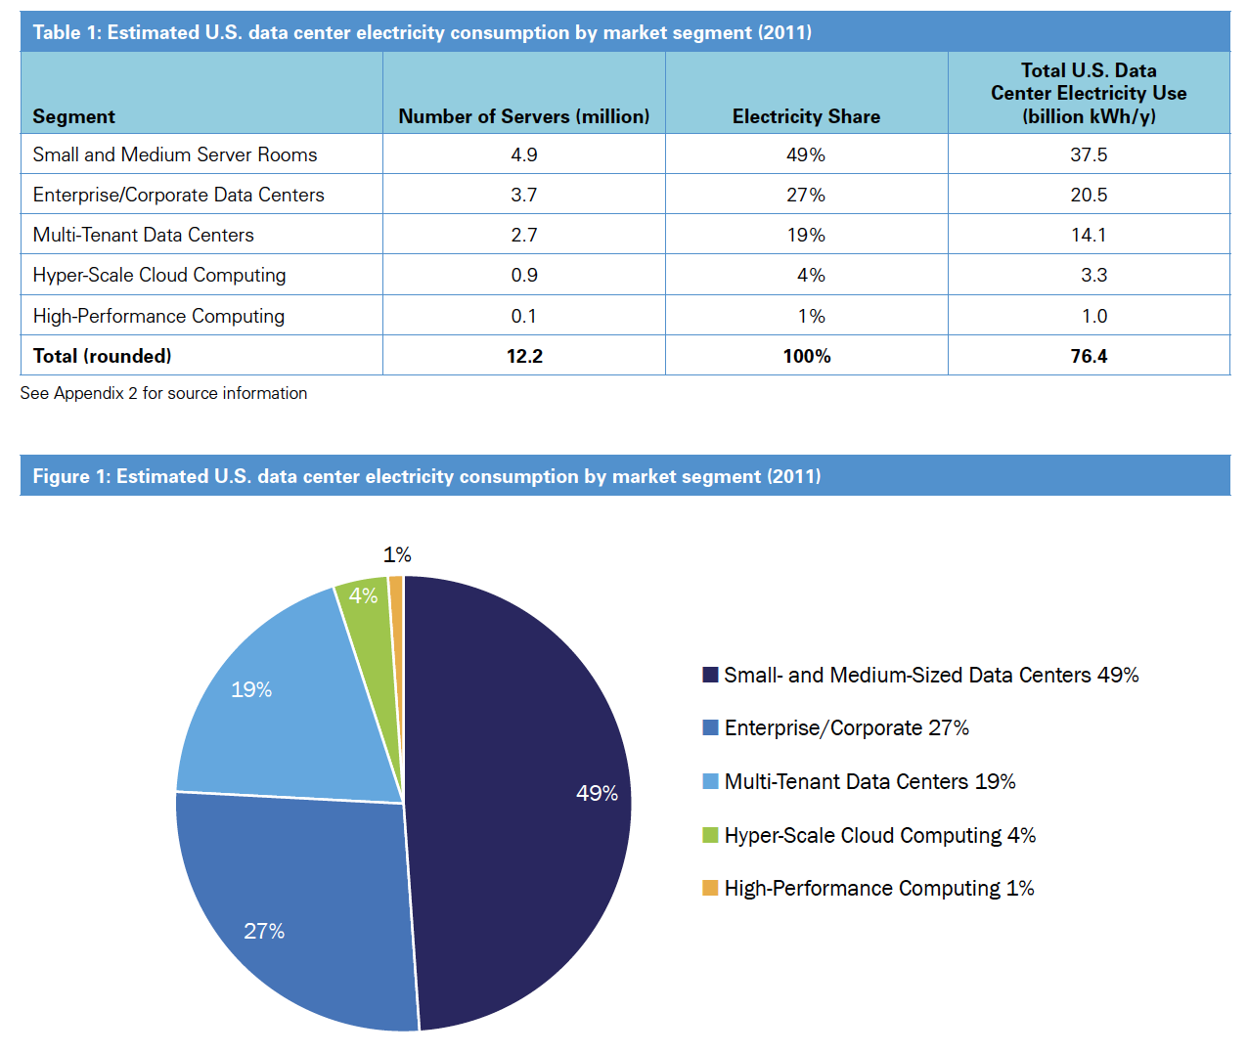
Breakdown wrt DC size
Source: NRDC research paper

Slide 22
Data Center Costs
Amortized Cost* | Component | Sub-Components
~45% | Servers | CPU, memory, disk
~25% | Power infrastructure | UPS, cooling, power distribution
~15% | Power draw | Electrical utility costs
~15% | Network | Switches, links, transit
*3 yr amortization for servers, 15 yr for infrastructure; 5% cost of money
Total cost varies
upwards of $1/4 B for mega data center
server costs dominate
network costs is still significant
Long provisioning timescales:
new servers purchased quarterly at best

Slide 23

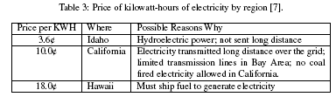
Table 2: Economies of Scale in 2006 for medium-sized datacenter (1000 servers) vs. very large datacenter (50,000 servers). [24]
(Courtesy of M. Ambrust, et al 2009)

Slide 24
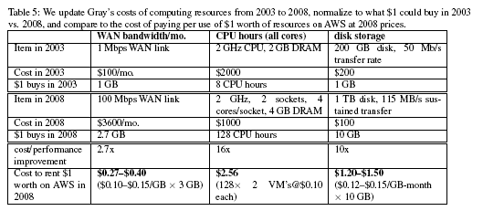
Cost Considerations : Power, Cooling, Physical Plant, and Operational Costs
(Courtesy of M. Ambrust, et al 2009)

Slide 25
DC network design questions
Core and aggregation switches much faster than ToR switches
How much faster should core and aggregation switches need to be than ToR switches?
How many ports do core/aggregation switches need to support for a given number of ToR switch ports?
How many cables need to be run in total for a N machine datacenter?
What bisection bandwidth can be achieved?
Q: Why can’t we just build a single BIG switch to interconnect all machines?

Slide 26
Data Center Design Requirements
Data centers typically run two types of applications
outward facing (e.g., serving web pages to users)
internal computations (e.g., MapReduce for web indexing)
Workloads are often unpredictable:
Multiple services run concurrently within a DC
Demand for new services may spike unexpectedly
Spike of demands for new services mean success!
But this is when success spells trouble (if one is not prepared)!
Failures of servers are the norm
Recall that GFS, MapReduce, etc., resort to dynamic re-assignment of chunkservers, jobs/tasks (worker servers) to deal with failures; data is often replicated across racks, …
“Traffic matrix” between servers are constantly changing

Slide 27
Data Center Costs
Amortized Cost* | Component | Sub-Components
~45% | Servers | CPU, memory, disk
~25% | Power infrastructure | UPS, cooling, power distribution
~15% | Power draw | Electrical utility costs
~15% | Network | Switches, links, transit
*3 yr amortization for servers, 15 yr for infrastructure; 5% cost of money
Total cost varies
upwards of $1/4 B for mega data center
server costs dominate
network costs significant
Long provisioning timescales:
new servers purchased quarterly at best

Slide 28
Networking Objectives
Provide Uniform high capacity
Capacity between servers limited only by their NICs
No need to consider topology when adding servers
=> In other words, high capacity between any two servers no matter which racks they are located in!
Have Performance isolation
Traffic of one service should be unaffected by others
Ease of management: “Plug-&-Play” (layer-2 semantics)
Flat addressing, so any server can have any IP address
Server configuration is the same as in a LAN
Legacy applications depending on broadcast must work

Slide 29
Cisco Recommended DC Structure: (Early days)
Internet
Internet
Data Center
Layer 3
CR
CR
AR
AR
…
AR
AR
Layer 2
LB
LB
S
S
Key:
CR = L3 Core Router
AR = L3 Access Router
S = L2 Switch
LB = Load Balancer
A = Rack of 20 servers
with Top of Rack switch
S
S
S
S
…
…
A
A
…
A
A
A
A

Slide 30
A Scalable, Commodity Data Center Network Architecture
Main Goal: addressing the limitations of today’s data center network architecture
single point of failure
Over-subscription of links higher up in the topology
Key Design Considerations/Goals
Allows host-host communication at line speed
no matter where they are located!
Backwards compatible with existing infrastructure
no changes in application & support of layer 2 (Ethernet)
Cost effective
cheap infrastructure
and low power consumption & heat emission

Slide 31
Data center networks: Fat Tree
rich interconnection among switches, racks:
increased throughput between racks (multiple routing paths possible)
increased reliability via redundancy
Tier-1 switches
Tier-2 switches
TOR switches
Server racks
1
2
3
4
5
6
7
8

Slide 32
Fat-Tree Based Topology (Cont.)
Why Fat-Tree?
Fat tree has identical bandwidth at any bisection
Bisection bandwidth: bandwidth across smallest cut that divides network into two equal halves
Bandwidth across “narrowest” part of the network
Each layer has the same aggregated bandwidth
Can be built using cheap devices with uniform capacity
Each port supports same speed as end host
All devices can transmit at line speed if packets are distributed uniformly along available paths
Great scalability
k-port switch supports k³/4 servers

Slide 33
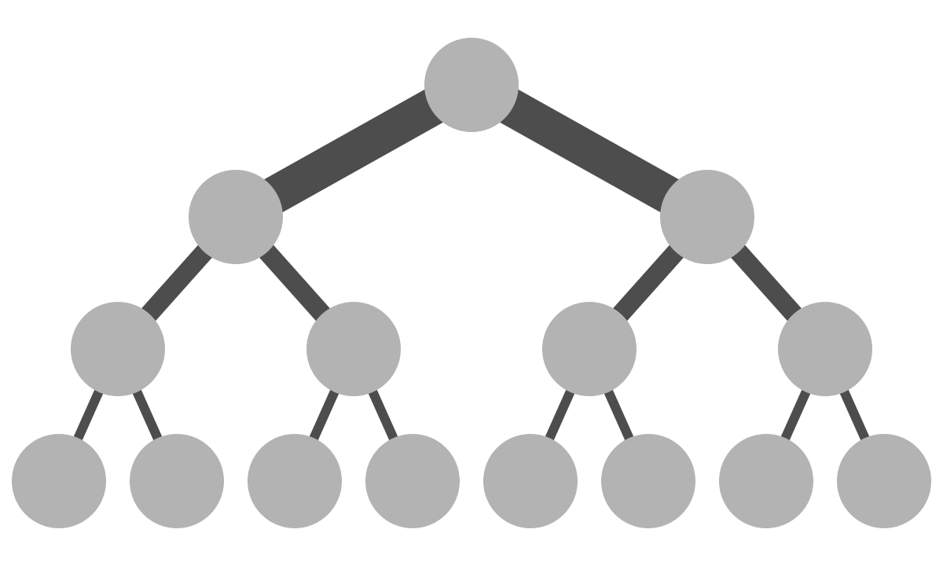
Fat-Tree Based Topology (Cont.)
Why Fat-Tree?
Fat tree has identical bandwidth at any bisection
Bisection bandwidth: bandwidth across smallest cut that divides network into two equal halves --- Bandwidth across “narrowest” part of the network
Each layer has the same aggregated bandwidth

Slide 34
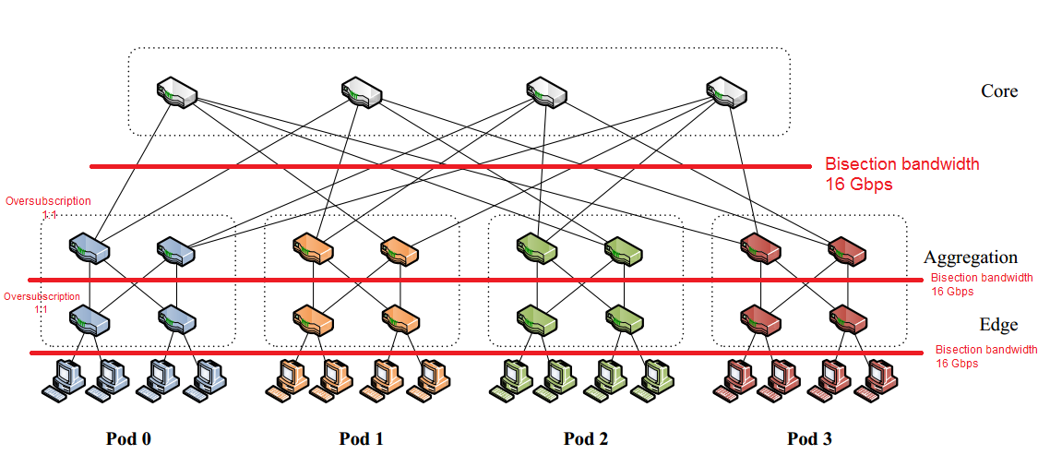
Bisection Bandwidth in a Fat Tree

Slide 35
Fat-Tree Based Topology (Cont.)
Why Fat-Tree?
Fat tree has identical bandwidth at any bisection
Bisection bandwidth: bandwidth across smallest cut that divides network into two equal halves
Bandwidth across “narrowest” part of the network
Each layer has the same aggregated bandwidth
Can be built using cheap devices with uniform capacity
Each port supports same speed as end host
All devices can transmit at line speed if packets are distributed uniformly along available paths
Great scalability
k-port switch supports k³/4 servers

Slide 36
Outline
Data Center Introduction
Data Center Network Architectures
Fat-Tree
VL2
DCell
BCube
FiConn

Slide 37
Data Center Networking
Major Theme:
What are new networking issues posed by large-scale data centers?
Network Architecture
Topology design
Addressing
Routing
Forwarding

Slide 38
Data Center Interconnection Structure
Nodes in the system: racks of servers
How are the nodes (racks) inter-connected?
Typically a hierarchical inter-connection structure
Original, typical smallish-data center structure
starting from the bottom level
rack switches
1-2 layers of (layer-2) aggregation switches
access routers
core routers
Is such an architecture good enough?

Slide 39
Design Characteristics of a Data Center Network
Topology (how things are connected):
Crossbar, ring, 2-D and 3-D meshes or torus, hypercube, tree, butterfly, perfect shuffle ....
Routing algorithm (path used):
Example in 2D torus: all east-west then all north-south (avoids deadlock).
Switching strategy:
Circuit switching: full path reserved for entire message, like the telephone network
Packet switching: message broken into separately-switched/routed packets.
Flow control (what if there is congestion):
Stall, store data temporarily in buffers, re-route data to other nodes, tell source node to temporarily halt, discard, etc.

Slide 40
Performance Properties of a Network: Bisection Bandwidth
Bisection bandwidth: bandwidth across smallest cut that divides network into two equal halves
Bandwidth across “narrowest” part of the network
not a
bisection
cut
bisection
cut
bisection bw= link bw
bisection bw = sqrt(n) * link bw
Bisection bandwidth is important for algorithms in which all processors need to communicate with all others

Slide 41
Cisco Recommended DC Structure: Illustration
Internet
Internet
Data Center
Layer 3
CR
CR
AR
AR
…
AR
AR
Layer 2
LB
LB
S
S
Key:
CR = L3 Core Router
AR = L3 Access Router
S = L2 Switch
LB = Load Balancer
A = Rack of 20 servers
with Top of Rack switch
S
S
S
S
…
…
A
A
…
A
A
A
A

Slide 42
Data Center Design Requirements
Data centers typically run two types of applications
outward facing (e.g., serving web pages to users)
internal computations (e.g., MapReduce for web indexing)
Workloads often unpredictable:
Multiple services run concurrently within a DC
Demand for new services may spike unexpectedly
Success: spike of demands for new services!
But this is when success spells trouble (if one is not prepared)!
Failures of servers are the norm
Recall that GFS, MapReduce, etc., resort to dynamic re-assignment of chunkservers, jobs/tasks (worker servers) to deal with failures; data is often replicated across racks, …
“Traffic matrix” between servers are constantly changing

Slide 43
Overall Data Center Design Goals
Important Goals
Agility – Any service, Any Server
Turn the servers into a single large fungible pool
Let services “breathe”: dynamically expand and contract their footprint as needed
We see this is done for Google’s GFS, BigTable, MapReduce
Increase service developer productivity
Lower cost
Achieve high performance and reliability
These are the motivators for most data center infrastructure projects!

Slide 44
Achieving Agility …
Workload Management
means for rapidly installing a service’s code on a server
dynamic cluster scheduling and server assignment ☑
E.g., MapReduce, Bigtable, …
virtual machines, disk images ☑
Storage Management
means for a server to access persistent data
distributed file systems (e.g., GFS) ☑
Network Management
Means for communicating with other servers, regardless of where they are in the data center
Achieve high performance and reliability

Slide 45
Networking Objectives
Uniform high capacity
Capacity between servers limited only by their NICs
Should not have to consider network topology when adding servers
=> In other words, high capacity between any two servers no matter which racks they are located in!
Performance isolation
Traffic of one service should be unaffected by others
Ease of management: “Plug-&-Play” (layer-2 semantics)
Flat addressing, so any server can have any IP address
Server configuration is the same as in a LAN
Legacy applications depending on broadcast must work

Slide 46
Additional Data Center Considerations
Hierarchical network; 1+1 redundancy
Equipment higher in the hierarchy handles more traffic
more expensive, more effort for availability ➔ scale-up design
Servers connect via 1-10 Gbps UTP to Top-of-Rack switches
Other links are mix of 1G, 10G, 100G; fiber, copper
Uniform high capacity?
Performance isolation?
typically via VLANs
Agility in terms of dynamically adding or shrinking servers?
Agility in terms of adapting to failures, and to traffic dynamics?
Ease of management?
Internet
Internet
Data Center
Layer 3
CR
CR
AR
AR
…
AR
AR
Layer 2
LB
LB
Key:
CR = L3 Core Router
AR = L3 Access Router
S = L2 Switch
LB = Load Balancer
A = Top of Rack switch
S
S
S
S
S
S
…
…
A
A
…
A
A
A
A

Slide 47
Modern Data Center Network Architectures: Options
Switch-centric
Servers use only 1 port for connection
Interconnection and routing intelligence put into switches
Fat-Tree, PortLand, VL2
Server-centric
Servers use multiple ports
Participate in packet forwarding
DCell, FiConn, BCube, MDCube, CamCube

Slide 48
Outline
Data Center Introduction
Data Center Network Architectures
Fat-Tree
VL2
DCell
BCube
FiConn

Slide 49
A Scalable, Commodity Data Center Network Architecture
Main Goal: addressing the limitations of today’s data center network architecture
single point of failure
Over-subscription of links higher up in the topology
Key Design Considerations/Goals
Allows host-host communication at line speed
no matter where they are located!
Backwards compatible with existing infrastructure
no changes in application & support of layer 2 (Ethernet)
Cost effective
cheap infrastructure
and low power consumption & heat emission

Slide 50
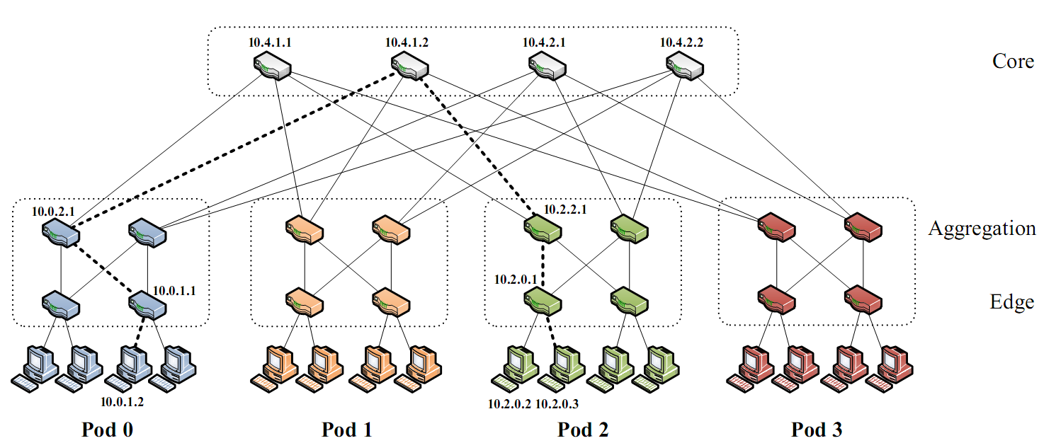
Fat-Tree Based DC Architecture
Inter-connect racks (of servers) using a fat-tree topology
Fat-Tree: a special type of Clos Network (after C. Clos)
K-ary fat tree: three-layer topology (edge, aggregation and core)
each pod consists of (k/2)² servers & 2 layers of k/2 k-port switches
each edge switch connects to k/2 servers & k/2 aggr. switches
each aggr. switch connects to k/2 edge & k/2 core switches
(k/2)² core switches: each connects to k pods; (Total: k³/4 servers)
Using 2-level routing table, pkts. from source 10.0.1.2 to 10.2.0.3 take the dashed path
Fat-tree
with K=4
[UCSD] A Scalable Commodity Data Center Network Architecture:
M. Al-Fares, A. Loukissas, A. Vahdat. ACM SIGCOMM 2008, pages 63-74.

Slide 51
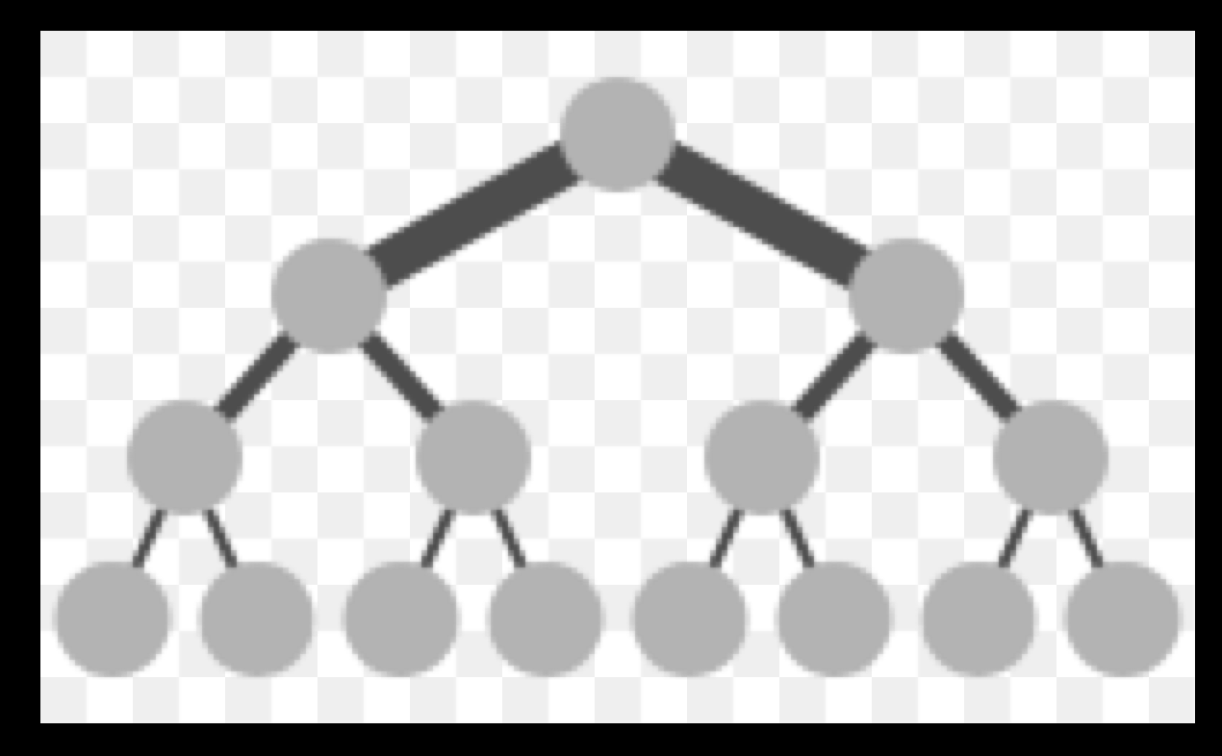
Fat tree topology
Core branches, i.e., those near the top of the hierarchy, are fatter or higher in capacity
e.g., 48- port GigE switches; consist of 48 pods, edge layer + aggregation layer w/24 switches each. Edge switches in every pod assigned to 24 hosts each.

Slide 52
Bisection of Fat Tree
Architecture provides full bisection bandwidth and
there is no oversubscription at the aggregation and edge switches.

Slide 53
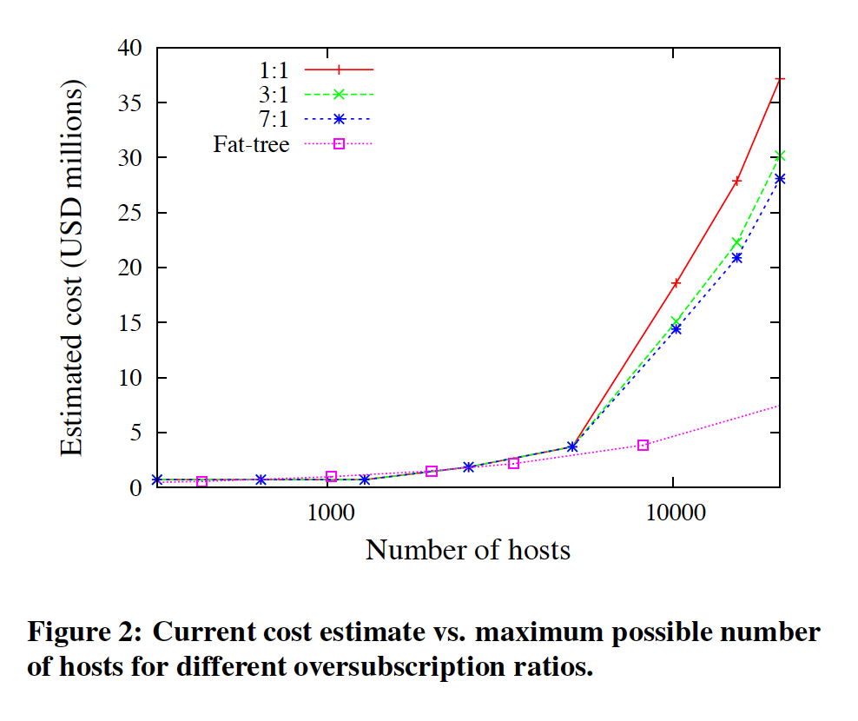
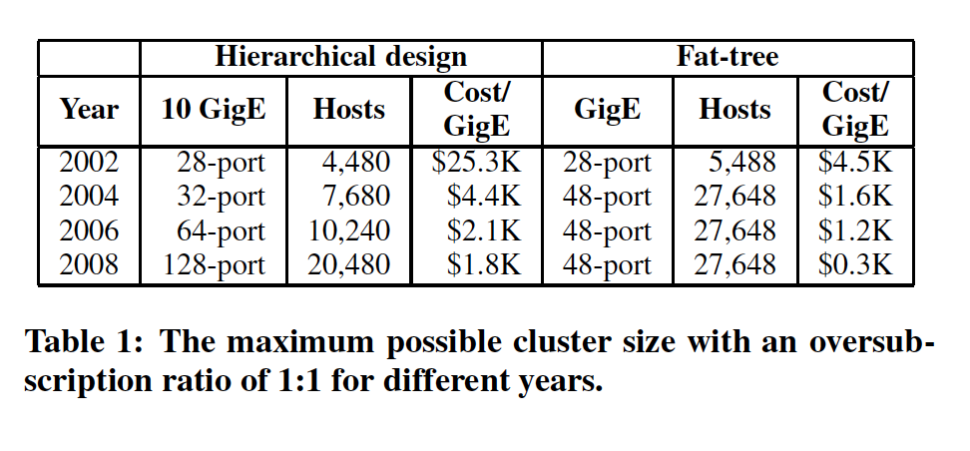
Why simpler hierarchies not good enough?
High cost
High oversubscription (ratio of worst-case aggregate bandwidth among end-hosts to bisection bandwidth)

Slide 54
Fat-tree Topology is Great, But …
Is using fat-tree topology to inter-connect racks of servers by itself sufficient?
What routing protocols should we run on these switches?
Layer 2 switch algorithm: results in data plane flooding!
Layer 3 IP routing:
shortest path IP routing will typically use only one path despite the path diversity in the topology
if using equal-cost multi-path routing at each switch independently and blindly, packet re-ordering may occur; further load may not necessarily be well-balanced
And: control plane flooding!

Slide 55
Optimizations to Distribute traffic
Flow classification
Eliminates local congestion
Assign traffic to ports on a per-flow basis instead of a per-host basis
Flow scheduling
Eliminate global congestion
Prevent long lived flows from sharing the same links
Assign long lived flows to different links

Slide 56
Design Goals for Network Fabric
Main consideration: Support for Agility
Easy configuration and management: plug-&-play
Fault tolerance, routing and addressing: scalability
Commodity switch hardware: small switch state
Virtualization support: seamless VM migration
Useful to evaluate approaches: Layer-2 (Ethernet w/ flat-addressing) vs. layer-3 (IP w/ prefix-based addressing) based on these considerations:
plug-&-play?
scalability?
small switch state?
seamless VM migration?

Slide 57
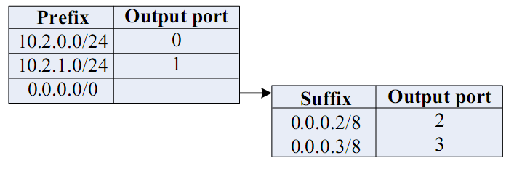
FAT-Tree Modified
Enforce a special (IP?) addressing scheme in DC
Unused.PodNumber.switchnumber.Endhost
Allows hosts attached to same switch to route only through switch
Allows intra-pod traffic to stay within pod
Use two level look-ups to distribute traffic and maintain packet ordering
First level is prefix lookup
used to route down the topology to servers
Second level is a suffix lookup
used to route up towards core
maintain packet ordering by using same ports for same server

Slide 58
Fat Tree Routing Example
Send packet from 10.0.1.2 to 10.2.0.3

Slide 59
Fat Tree Routing Example
2
3
0
1
3
2
0
1
At Switch (10.0.2.1)
dest ip = 10.2.0.3
since no prefix exists, follow default and go to suffix table
Suffix = 3 ( from dest IP 10.2.0.3)
Output port =3 to 10.4.1.2
S: 10.0.2.1
Prefixes | Port
10.0.0.0/24 | 0
10.0.1.0/24 | 1
0.0.0.0/8
Sufffixes | Port
0.0.0.2/8 | 2
0.0.0.3/8 | 3

Slide 60
Fat Tree Routing Example
0
2
3
1
At Switch (10.4.1.2)
dest ip = 10.2.0.3
prefix exists
Output port =2 to 10.2.2.1
S: 10.4.1.2
Prefixes | Port
10.0.0.0/16 | 0
10.1.0.0/16 | 1
10.2.0.0/16 | 2
10.3.0.0/16 | 3

Slide 61
Fat Tree Routing Example
0
1
2
At Switch (10.2.2.1)
dest ip = 10.2.0.3
Terminating prefix exists
(i.e. destination host on current pod)
Output port = 0 to 10.2.0.1
S: 10.2.2.1
Prefixes | Port
10.2.0.1/24 | 0
10.2.1.0/24 | 1
0.0.0.0/8
Prefixes | Port
0.0.0.2/8 | 3
0.0.0.3/8 | 2

Slide 62
Fat Tree Routing Example
At Switch (10.2.0.1)
dest ip = 10.2.0.3
Terminating switch
Standard switching techniques deliver packet to end host
S: 10.2.0.1
Prefixes | Port
10.2.0.0/24 | 0
10.2.1.0/24 | 1
0.0.0.0/8
Prefixes | Port
0.0.0.2/8 | 3
0.0.0.3/8 | 2

Slide 63
Fat Tree Routing Example All tables
S: 10.0.1.1
S: 10.2.2.1
Prefixes | Port
10.0.0.0/24 | 0
10.0.1.0/24 | 1
0.0.0.0/8
Prefixes | Port
0.0.0.2/8 | 3
0.0.0.3/8 | 2
Prefixes | Port
10.2.0.1/24 | 0
10.2.1.0/24 | 1
0.0.0.0/8
Prefixes | Port
0.0.0.2/8 | 3
0.0.0.3/8 | 2
S: 10.0.2.1
Prefixes | Port
10.0.0.0/24 | 0
10.0.1.0/24 | 1
0.0.0.0/8
Prefixes | Port
0.0.0.2/8 | 2
0.0.0.3/8 | 3
S: 10.2.0.1
Prefixes | Port
10.2.0.0/24 | 0
10.2.1.0/24 | 1
0.0.0.0/8
Prefixes | Port
0.0.0.2/8 | 3
0.0.0.3/8 | 2
S: 10.4.1.2
Prefixes | Port
10.0.0.0/16 | 0
10.1.0.0/16 | 1
10.2.0.0/16 | 2
10.3.0.0/16 | 3

Slide 64
PortLand: A Scalable Fault-Tolerant Layer 2 Data Center Network Fabric
PortLand is a single “logical layer 2” data center network fabric that is meant to enable large scale
PortLand internally separates host identity from host location
Uses IP address as host identifier
introduces “Pseudo MAC” (PMAC) addresses internally to encode endpoint location
PortLand runs on commodity switch hardware with unmodified hosts
Read: Sigcomm 2009 paper on Portland, from UCSD

Slide 65
PortLand Solution
Assume: a Fat-tree network topology for DC
Introduce “pseudo MAC addresses” to balance the pros and cons of flat- vs. topology-dependent addressing
PMACs are “topology-dependent,” hierarchical addresses
But used only as “host locators,” not “host identities”
IP addresses used as “host identities” (for compatibility w/ apps)
Pros: small switch state & Seamless VM migration
Pros: “eliminate” flooding in both data & control planes
But requires a IP-to-PMAC mapping and name resolution
a location directory service
And location discovery protocol & fabric manager
for support of “plug-&-play”

Slide 66
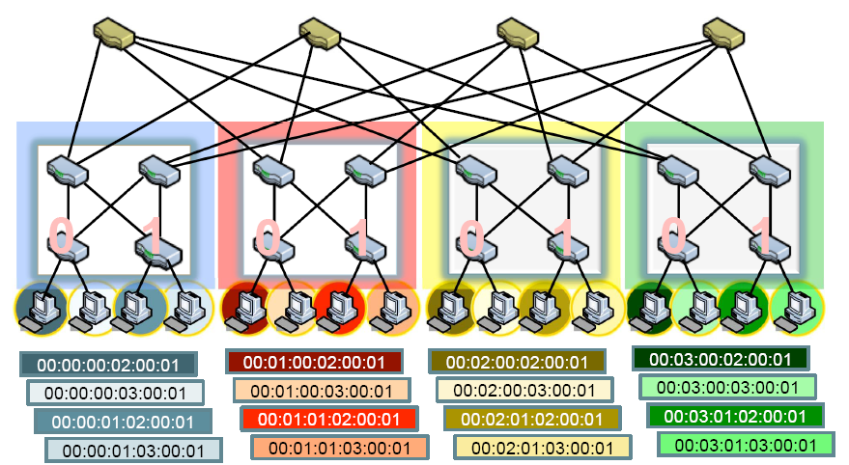
PMAC Addressing Scheme
PMAC (48 bits): pod.position.port.vmid
Pod: first 16 bits; position and port (8 bits each); vmid: last 16 bits
Assign only to servers (end-hosts) – by switches
Core
Pod
0
1
2
3
Aggregation
Position
Edge
Port
2
3

Slide 67
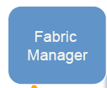
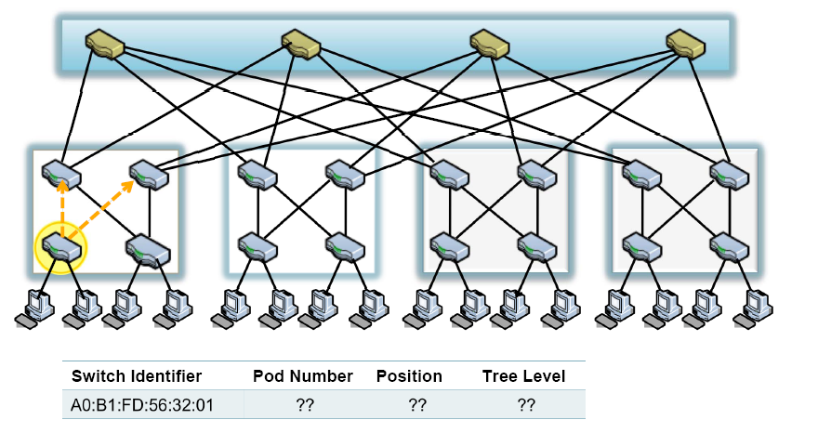

Location Discovery Protocol
Location Discovery Messages (LDMs) exchanged between neighboring switches
Switches self-discover location on boot up
Location Characteristics Technique
Tree-level (edge, aggr. , core) auto-discovery via neighbor connectivity
Position # aggregation switch help edge switches decide
Pod # request (by pos. 0 switch only) to fabric manager
Core
0
1
2
3
Aggregation
0
1
0
1
0
1
Edge

Slide 68
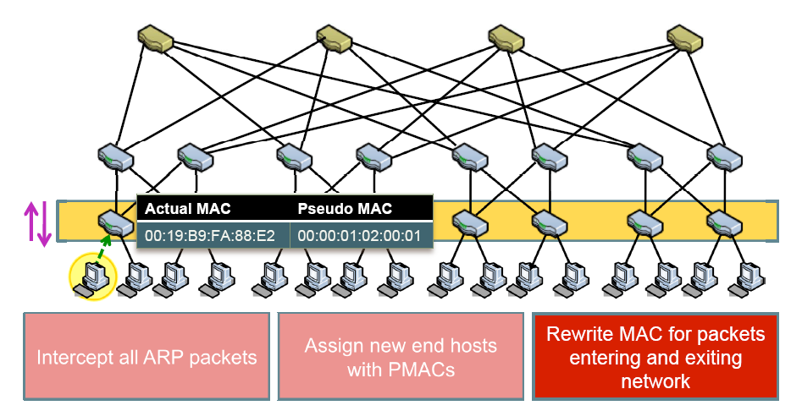
PortLand: Name Resolution
Edge switch listens to end hosts, and discover new source hardware MACs and IP address based on ARP source info’
Edge switch can assign the Pseudo MAC address for each host-VM (it knows the pod#, position. has to assign a Vmid)
Installs <IP, PMAC> mappings for the source of the ARP, and informs fabric manager
Recall: PMAC: pod.position.port.vmid

Slide 69
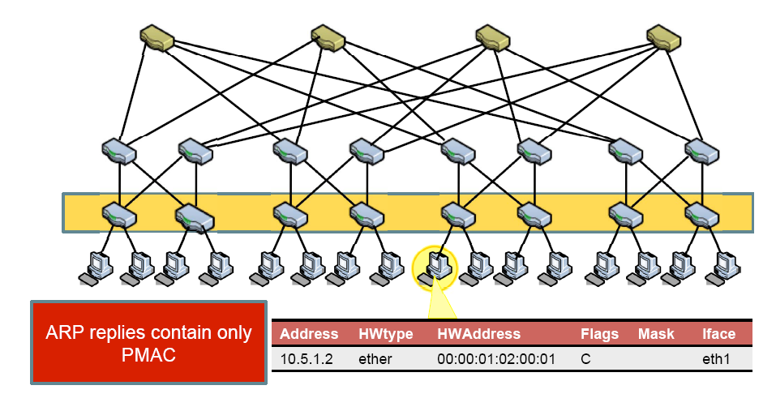
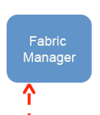
PortLand: Name Resolution (Cont.)
Edge switch intercepts ARP messages from end hosts
To resolve IP address of destination, the edge switch needs to consult the resolver: Fabric Manager.
Send request to fabric manager, which replies with PMAC of destination host

Slide 70
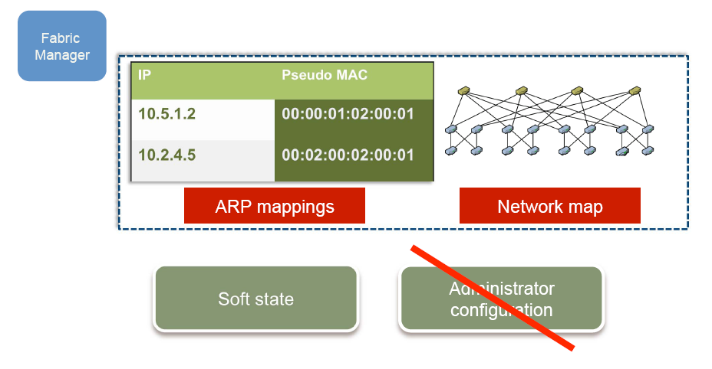
PortLand: Fabric Manager
fabric manager: logically centralized, multi-homed (ARP resolution) server
maintains topology and <IP,PMAC> mappings in “soft state”

Slide 71
Loop-free Forwarding and Fault-Tolerant Routing
Switches build forwarding tables based on their position
edge, aggregation and core switches
Use strict “up-down semantics” to ensure loop-free forwarding
Load-balancing: use any ECMP path
flow hashing to ensure packet ordering
Fault-tolerant routing:
Mostly concerned with detecting failures
Fabric manager maintains logical fault matrix with per-link connectivity info; inform affected switches
Affected switches re-compute forwarding tables

Slide 72
Outline
Data Center Introduction
Data Center Network Architectures
Fat-Tree
VL2
DCell
BCube
FiConn
Read: Sigcomm 2009 paper

Slide 73
VL2: Motivation
The network is a bottleneck to Data Center computation.
Today’s data center network has several issues:
Tree architecture
Congestion and computation hot spot
Traffic Independence
IP configuration Complexity
Especially to deal with Migration
Tradeoff
Reliability and utilization
Read: Sigcomm 2009 paper on VL2

Slide 74
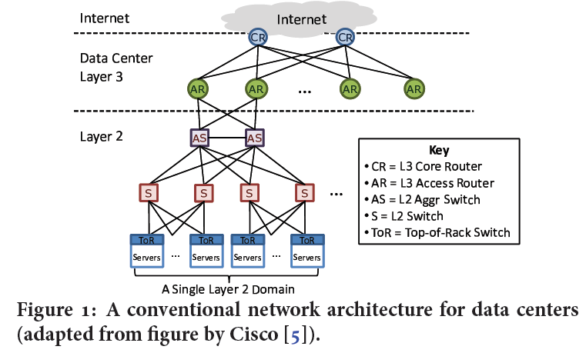
Conventional Data Center Architecture
Notes:
packet flooding and ARP broadcasts

Slide 75
Design of VL2
Location-specific IP address(LAs)
For all switches and interfaces or servers
Application-specific IP addresses (AAs)
For application servers
VL2 Directory System
Stores the mapping of AAs to LAs
Also provides Access control
Read: VL2: A Scalable and Flexible Data Center Network, Sigcomm 2009 paper

Slide 76
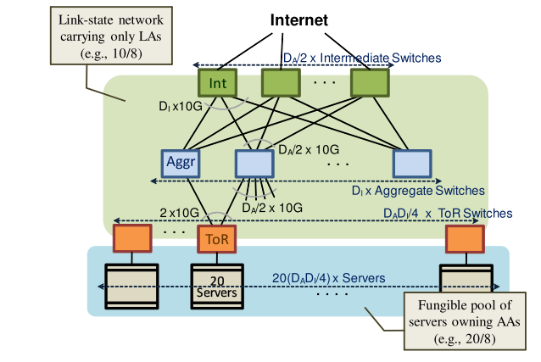
Scale-out Topologies
Aggr : Int = n:m
ToR : Aggr = 1:2

Slide 77
Scale-out Topologies Benefit
Risk balancing
The failure of an Int. switch reduces the bisection bandwidth by only 1/m
Routing is extremely simple on this topology
Random path up and non-random (SPF) path down.
Called Valiant Routing (1981) and Valiant Load Balancing
Sender S sends pkts to Dest. D via randomly chosen intermediate switch using IP-in-IP encapsulation.
AAs are from a different subnet (e.g., 20/8) and LAs from another subnet (e.g., 10/8)
Note: H(ft) denotes a hash of the five tuple

Slide 78
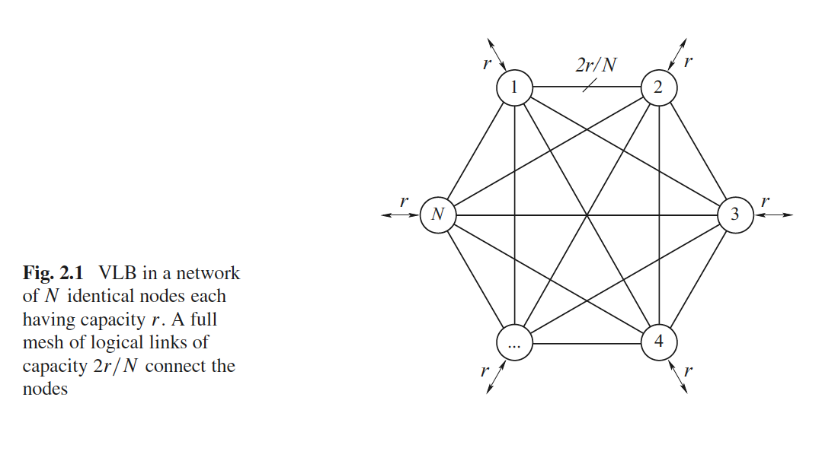
Valiant load balancing
Randomization for efficient, load-balanced routing [VLB]
[VLB] Valiant Load-Balancing: Building Networks That Can Support All Traffic Matrices

Slide 79
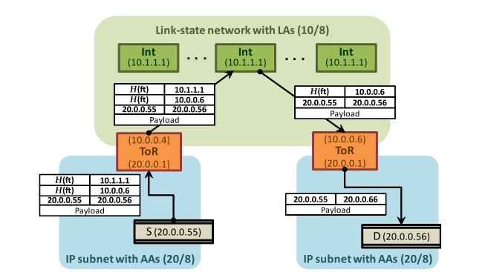
Example
Randomly select Int. by ECMP
Create by VL2 Agent

Slide 80

VL2 agent
VL2 agent’s work flow
Intercepts the ARP request for the destination Application Specific IP Address (AA)
Converts that ARP request to a unicast query to the VL2 directory system
Intercepts packets from the host
Encapsulates the packet with the Location-specific IP address (LA) address obtained from the VL2 directory.
Caches the mapping from AA to LA addresses

Slide 81
VL2 Addressing and Routing
VL2
Switches run link-state routing and maintain only switch-level topology
Directory Service
LAs
…
x → ToR₂
y → ToR₃
z → ToR₄
…
…
x → ToR₂
y → ToR₃
z → ToR₃
…
ToR₁
. . .
ToR₂
. . .
ToR₃
. . .
ToR₄
ToR₃
y
payload
Lookup &
Response
y, z
ToR₄
x
y
z
ToR₃
z
z
payload
payload
AAs
Servers use flat names
Notes:
Here is how VL2 addressing and routing look like:
Switches run link-state routing and maintain only switch-level topology

Slide 82
Random Traffic Spreading over Multiple Paths
I_{ANY}
I_{ANY}
I_{ANY}
Links used for up paths
Links used for down paths
T₁
T₂
T₃
T₄
T₅
T₆
I_{ANY}
T₃
T₅
y
z
payload
payload
x
y
z
Use a combination of ECMP and Valiant Load Balancing to distribute traffic
across intermediate paths/switches for each transfer
Notes:
To overcome hot-spot-free performance for arbitrary traffic matrices, VL2 uses two related mechanisms: VLB and ECMP…goals of both are similar — VLB distributes traffic across a set of inter-mediate nodes and ECMP distributes across equal-cost paths—but each is needed to overcome limitations in the other. VL2 uses flows, rather than packets, as the basic unit of traffic spreading and thus avoids out-of-order delivery.

Slide 83
VL2 Directory System
VL2 has a modest number (50-100 directory server nodes for 100K servers) of read-optimized, replicated directory servers that cache AA-to-LA mappings and handle queries from VL2 agents, AND
a small number (5-10 servers) of write-optimized, asynchronous replicated state machine (RSM) servers that offer a strongly consistent, reliable store of AA-to-LA mappings.
The directory servers ensure low latency, high throughput, and high availability for a high lookup rate. Meanwhile, the RSM servers ensure strong consistency and durability.

Slide 84
VL2 Directory System
RSM
Replicated State Machine Servers
strongly consistent,
reliable store of
AA-to-LA mappings
3. Replicate
RSM
RSM
2. Set
4. Ack
(6. Disseminate)
. . .
. . .
. . .
Directory Servers
(cache)
DS
DS
DS
2. Reply
2. Reply
5. Ack
1. Lookup
1. Update
Agent
Agent
“Lookup”
“Update”
Notes:
VL2 consists of (1) a modest number (50-100 servers for 100K servers) of read-optimized, replicated directory servers that cache AA-to-LA mappings and handle queries fromVL2 agents, and (2) a small number (5-10 servers) of write-optimized, asynchronous replicated state machine (RSM) servers that offer a strongly consistent, reliable store of AA-to-LA mappings. The directory servers ensure low latency, high throughput, and high availability for a high lookup rate. Meanwhile, the RSM servers ensure strong consistency and durability.

Slide 85
Advantage of VL2
Load Balancing
Randomizing with VLB enables coping with Volatility
Built on well-understood networking technology
link-state routing,
equal-cost multi-path(ECMP) forwarding,
IP anycasting,
IP multicasting
Simple Migration
Static AAs
Only need to update AAs to LAs mapping
Eliminates the ARP and DHCP scaling bottlenecks

Slide 86
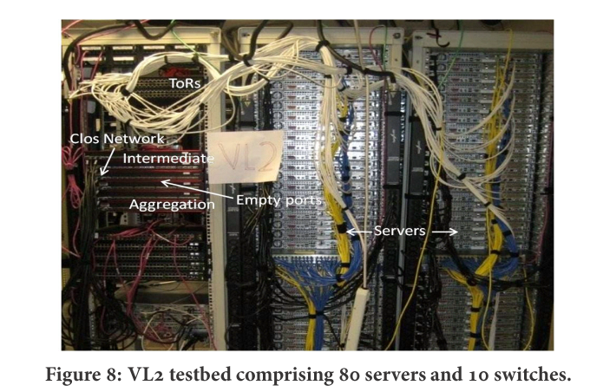
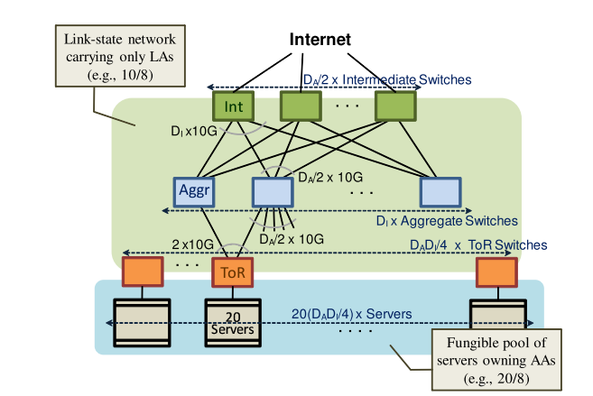
Evaluation: testbed
80 servers
5 for directory system
Intermediate switches (3)
24 10Gbps Ethernet ports(3 for Aggr)
Aggregation switches(3)
24 10Gbps Ethernet ports(3 for Aggr, 3 for ToR)
ToR (4)
24 1Gbps ports

Slide 87
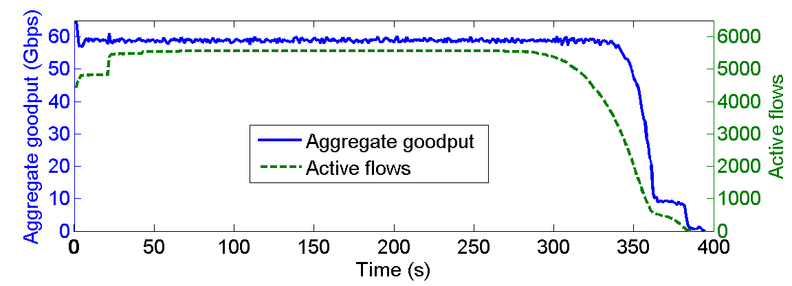
Evaluation
Uniform high capacity:
All-to-all data shuffle stress test:
75 servers, deliver 500MB
Maximal achievable goodput is 62.3
VL2 network efficiency as 58.8/62.3 = 94%
Notes:
This figure shows the aggregate goodput during a 2.7TB shuffle among 75 servers.
We can see that the Maximal achievable goodput is 62.3, and
VL2 network efficiency as 58.8/62.3 = 94%

Slide 88
Critique
The extra servers are needed to support the VL2 directory system:
Brings more cost on devices
Hard to be implemented for data centers with tens of thousands of servers.
All links and switches are working all the time, not power efficient
No evaluation of real time performance.
Notes:
But there are also some critiques:
The extra servers are needed to support the VL2 directory system,:
Brings more cost on devices
Hard to be implemented for data centers with tens of thousands of servers.
All links and switches are working all the times, not power efficient
No evaluation of real time performance.

Slide 89
Outline
Data Center Introduction
Data Center Network Architectures
Fat-Tree
VL2
DCell
BCube
FiConn

Slide 90

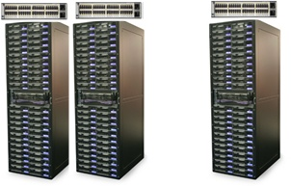
DCell
Existing tree structure does not scale
DCell
90
Notes:
Expensive high-end switches to scale up
Single point of failure and bandwidth bottleneck
Experiences from real systems

Slide 91
DCell Ideas
#1: Use mini-switches to scale out
#2: Leverage servers be part of the routing infrastructure
Servers have multiple ports and need to forward packets
#3: Use recursion to scale and build complete graph to increase capacity
Read: DCell: A Scalable and Fault-Tolerant Network Structure for Data Centers— Sigcomm 2008
Notes:
The basic ideas of DCell can be summarized as follows:
#1: Use mini-switches to scale out
#2: Leverage servers be part of the routing infrastructure
Servers have multiple ports and need to forward packets
#3: Use recursion to scale and build complete graph to increase capacity

Slide 92
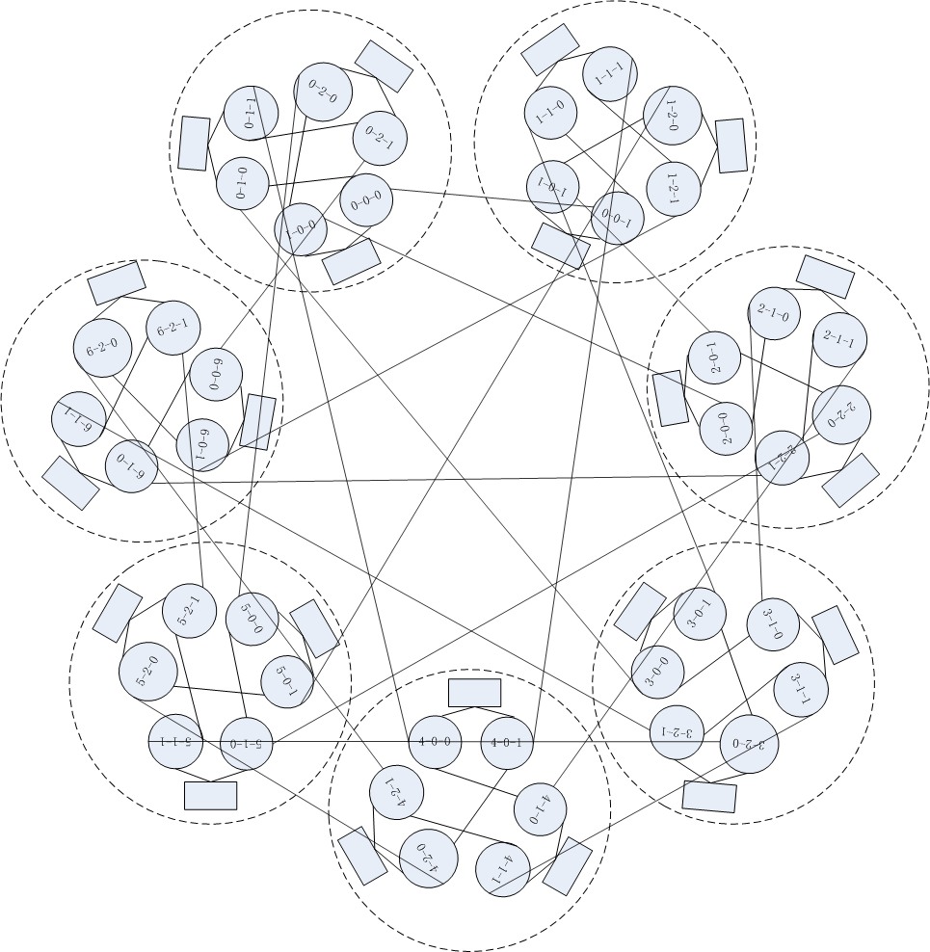
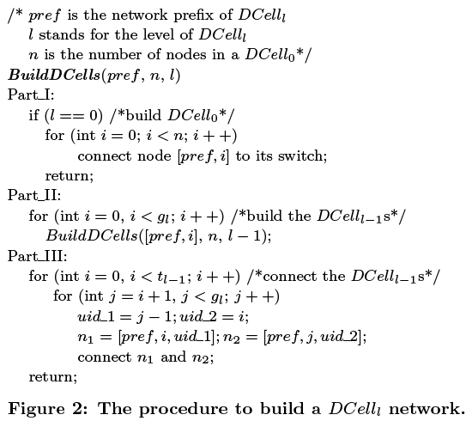
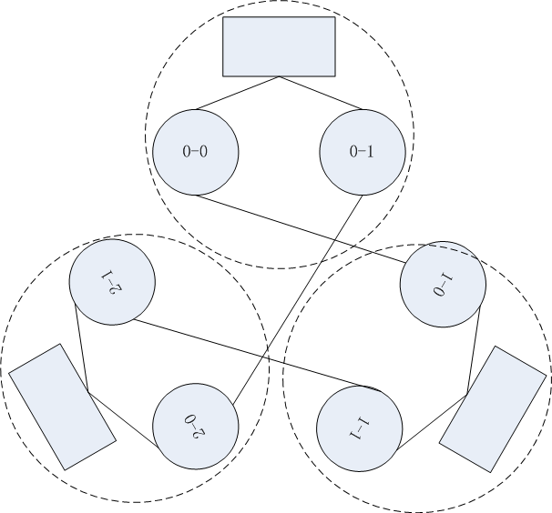
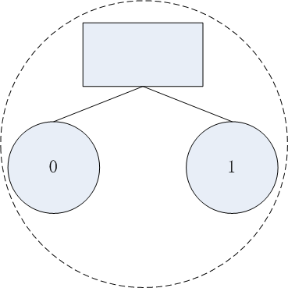
DCell: the Construction
Dcell_2
n=2, k=2
DCell_1
Dcell_0
Mini-switch
n=2, k=1
End recursion by building DCell0
Build sub-DCells
Server
Connect sub-DCells to form complete graph
n servers in a DCell_0
n=2, k=0
Notes:
This slide show the Dcell architecture and the procedure to build a DCell network.

Slide 93
BCube
Bcube
Leverage servers to be part of the routing infrastructure
Servers have multiple ports and need to forward packets
Use recursion to scale and build complete graph to increase capacity
BCube: A High Performance, Server-centric Network Architecture for Modular Data Centers
Sigcomm 2009

Slide 94
BCube design goals
High network capacity for various traffic patterns
One-to-one unicast
One-to-all and one-to-several reliable groupcast
All-to-all data shuffling
Only use low-end, commodity switches
Graceful performance degradation
Performance degrades gracefully as servers/switches failures increase
Notes:
The design of BCube is to meet the following goals:
High network capacity for various traffic patterns
Only use low-end, commodity switches
Graceful performance degradation

Slide 95
BCube structure
BCube1
<1,0>
A BCube_{k} network supports servers
n is the number of servers in a BCube₀
k is the level of that BCube
A server is assigned a BCube addr (a_{k},a_{k-1},…,a₀) where a_{i} ∈[0,k]
Neighboring server addresses differ in only one digit
<1,1>
<1,2>
<1,3>
Level-1
BCube0
<0,0>
<0,1>
<0,2>
<0,3>
Level-0
00
01
02
03
10
11
12
13
20
21
22
23
30
31
32
33
Connecting rule
The i-th server in the j-th BCube₀ connects to the j-th port of the i-th level-1 switch
shown: a BCube1 with n = 4; each server has two ports.
switch
server
Notes:
This slide shows the Bcube structure.
BCube is a recursively defined structure
There are two types of devices in BCube: Servers with multiple ports, and switches that connect a constant number of servers.

Slide 96
BCube: Server centric network
BCube1
Switch <1,3> MAC table
Server-centric BCube
Switches never connect to other switches and only act as L2 crossbars
Servers control routing, load balancing, fault-tolerance
port
<1,0>
<1,1>
<1,2>
<1,3>
MAC03
0
MAC13
1
MAC23
MAC03
MAC23
2
Switch <0,2> MAC table
MAC33
3
20
03
port
BCube0
MAC20
0
data
<0,0>
MAC21
1
<0,1>
<0,2>
<0,3>
MAC22
2
MAC23
3
MAC20
MAC23
20
03
00
01
02
10
11
12
20
data
03
13
21
22
23
30
31
32
33
dst
src
MAC addr
MAC23
MAC03
MAC20
MAC23
20
03
20
03
Bcube addr
data
data
MACnn are
addresses for
servers
Notes:
Bcube is a server centric network.
In Bcube:
Switches never connect to other switches and only act as L2 crossbars
Servers control routing, load balancing, fault-tolerance

Slide 97
Multi-paths for one-to-one traffic
Theorem 1. The diameter of a BCube_{k} is k+1
Theorem 2. There are k+1 parallel paths between any two servers in a BCubek
<1,0>
<1,1>
<1,2>
<1,3>
<0,0>
<0,1>
<0,2>
<0,3>
00
01
02
03
10
11
12
13
20
21
22
23
30
31
32
33
Notes:
This slide shows the multi-paths for one-to-one traffic in Bcube.
Two parallel paths between a source server and a destina-
tion server exist if they are node-disjoint, i.e., the interme-
diate servers and switches on one path do not appear on the
other.
Two theorems hold for Bcube:
Theorem 1. The diameter of a BCube_{k} is k+1
Theorem 2. There are k+1 parallel paths between any two servers in a BCubek
In practice, k is a small integer, typically at most 3. There-
fore, BCube is a low-diameter network.

Slide 98
Speedup for one-to-several traffic
Theorem 3. Server A and a set of servers {di|di is A’s level-i neighbor} form an edge disjoint complete graph of diameter 2
<1,0>
<1,1>
<1,2>
<1,3>
<0,0>
<0,1>
<0,2>
<0,3>
00
01
02
03
10
11
12
13
20
21
22
23
30
31
32
33
P1
P1
P1
P2
P2
P2
Notes:
Edge-disjoint complete graphs with k + 2 servers can be efficiently constructed in a Bcube of size k. These complete graphs can speed up data replications in distributed file systems like GFS.

Slide 99
BCube Source Routing (BSR)
Server-centric source routing
Source server decides the best path for a flow by probing a set of parallel paths
Source server adapts to network condition by re-probing periodically or responding to failures
BSR design rationale
Network structural property
Scalability
Routing performance
Notes:
It is required that the routing protocol be able to fully utilize the high capacity (e.g., multi-path) of BCube and automatically load-balance the traffic.
Existing routing protocols such as OSPF and IS-IS cannot meet these requirements.
Furthermore, it is unlikely that OSPF and IS-IS can scale to several thousands of routers. As a result, Bcube uses a source routing protocol called BSR by
leveraging BCube's topological property. BSR achieves load balance and fault tolerance, and enables graceful performance degradation.

Slide 100
BCube Source Routing
BCube stores the complete path and a next hop index (NHI) in the header of every BCube packet.
Since neighboring servers in BCube differ in only one digit in their address - reduce the space needed for an intermediate server

Slide 101
Path compression and fast packet forwarding
Traditional address array needs 16 bytes:
Path(00,13) = {02,22,23,13}
Forwarding table of server 23
NHI | Output port | MAC
0:0 | 0 | Mac20
0:1 | 0 | Mac21
0:2 | 0 | Mac22
1:0 | 1 | Mac03
1:1 | 1 | Mac13
1:3 | 1 | Mac33
The Next Hop Index (NHI) Array needs 4 bytes:
Path(00,13)={1:2,1:2,0:3,1:1}
<1,0>
<1,1>
<1,2>
<1,3>
Fwd node
2 3
Next hop
1 3
<0,0>
<0,1>
<0,2>
<0,3>
00
01
02
03
10
11
12
13
20
21
22
23
30
31
32
33
Notes:
This slide shows how path compression and fast packet forwarding is done in Bcube.
BCube stores the complete path and a next hop index (NHI) in the header of every BCube packet.

Slide 102
Routing to external networks
Ethernet has two levels of link rates: hierarchy
1G for end hosts and 10G for uplink
aggregator
10G
<1,0>
<1,1>
<1,1>
<1,2>
<1,3>
<1,1>
<1,3>
1G
<0,0>
<0,1>
<0,2>
<0,3>
00
01
01
02
10
11
11
12
20
21
21
22
30
31
03
13
23
31
32
33
gateway
gateway
gateway
gateway
Notes:
So far, we focus on how to route packets inside a Bcube network. Now, we consider how Internal servers communicates with external computers in the Internet or other containers.
BCube uses aggregator and gateway for external communication. An aggregator is simply a commodity layer-2 switch
with 10G uplinks.

Slide 103
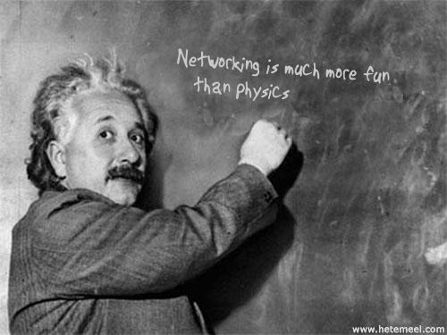
Q & A

